Slide 2
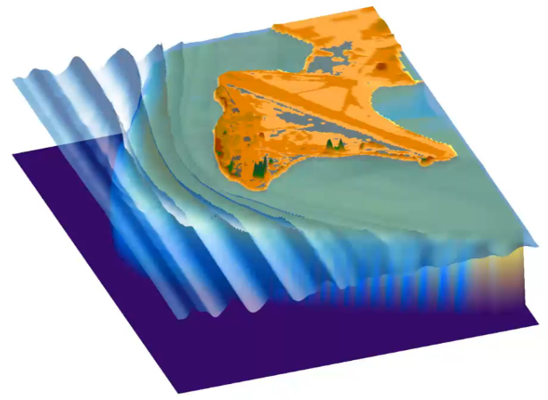
Numerical simulation of wave runup and coastal flooding in Roi-Namur.

Slide 3
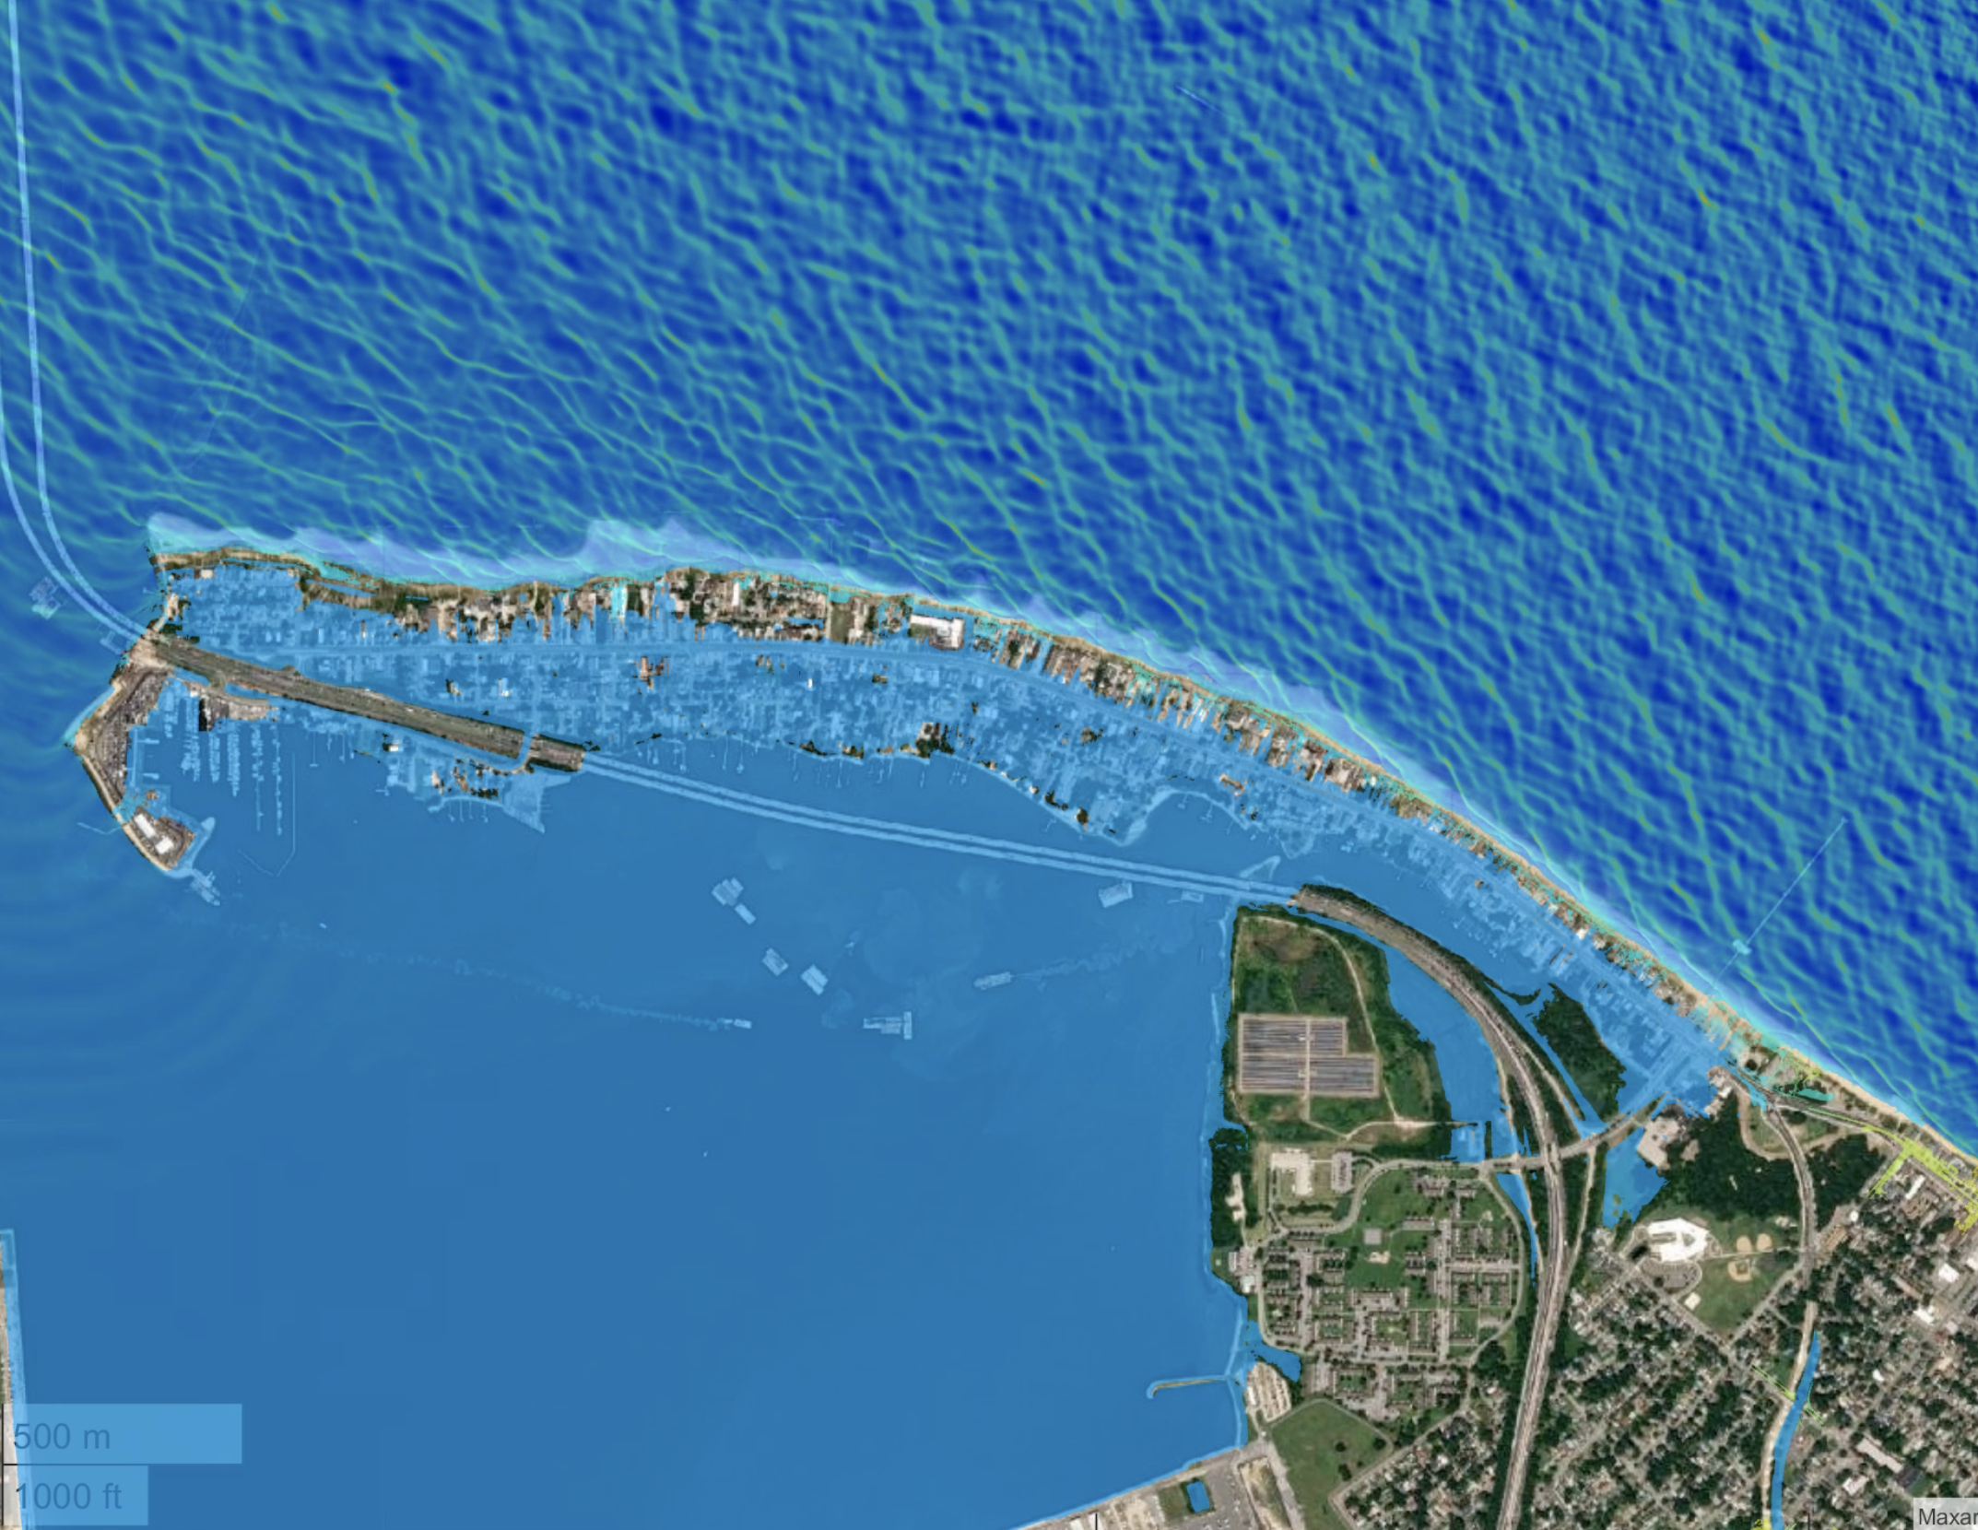
FUNWAVE simulation of Hurricane Irene
Click image for animation

